Slide 1
Encounters With Jesus – No. 5
A Man Under Authority
LUKE 7 : 1- 10

Slide 2
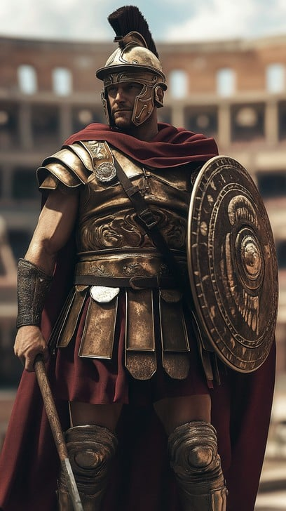
Centurion

Slide 3


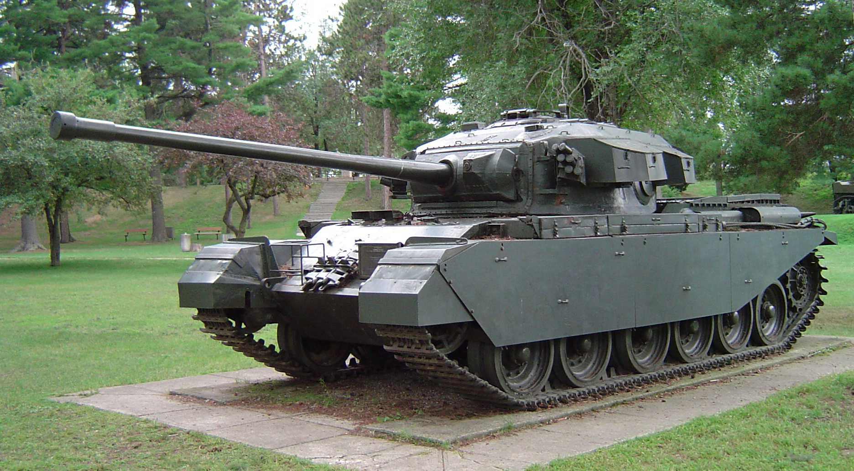
Centurions

Slide 4
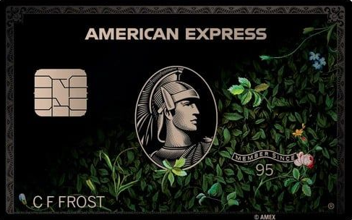

Centurions

Slide 5
Centurion
1. THE POWER OF AUTHORITY
2. DEEP HUMILITY
3. SELFLESS COMPASSION

Slide 6
APPLICATION
1. FAITH
2. AUTHORITY
3. RESOLUTION

Slide 7
SCRIPTURES
1. Philippians 2 : 3 - 9
2. James 4 : 6
3. 2 Chronicles 7 : 14
4. John 14 : 13
5. 1 Timothy 2 : 1 - 4

Slide 8

BE
AMAZING !

