Slide 1



Slide 2



LEADERSHIP
ADMINISTRATION
DREAM INTERPRETATION

Slide 3


Slide 4



Kubernesis:-
To “steer or to pilot”
ADMINISTRATION

Slide 5
ADMINISTRATION
Kubernesis:-
“The divine ability to organise people, resources, and tasks to effectively achieve God-given vision and goals, steering ministries and the church towards its purpose, much like a ship's captain guiding a vessel. It's about creating order out of chaos, bringing structure, managing details, and ensuring smooth operations so others can focus on their primary callings, making it crucial for the body of Christ to function cohesively and grow”

Slide 6

LEADERSHIP

Slide 7
SHORT DESCRIPTION:-
Having a servant heart
LEADERSHIP
LONG DESCRIPTION:
The supernatural ability God gives some believers to guide, inspire, and direct others towards a shared, God-honouring vision, focusing on unity, service, and furthering the Kingdom. It involves seeing the bigger picture, mobilising people, and leading by example, characterised by humility, vision, and a shepherd's heart, distinct from mere management or charisma.

Slide 8


LEADERSHIP
John 13: 12-17 + Mark 10:45 + Genesis 1:26

Slide 9

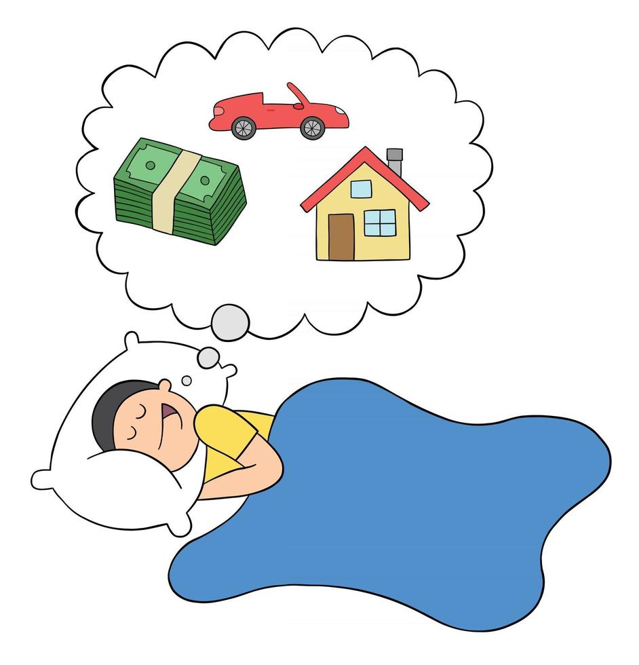
DREAMS & DREAM INTERPRETATION

Slide 10



DREAMS & DREAM INTERPRETATION
LONG DESCRIPTION:
The divine ability, to understand messages, guidance, or prophecies from God within dreams, distinguishing them from everyday thoughts or anxieties. It's considered a powerful gift that allows individuals to discern spiritual mysteries, receive revelation, and act as instruments for God's purposes, often requiring prayer, study, and practice to develop. It's not just about knowing the future but also understanding motives, receiving warnings, or experiencing divine presence, with interpretations sometimes revealing deep, symbolic meanings requiring further spiritual insight.

Slide 11


REMAIN
PRIMARILY
RELIANT ON THE WORD OF GOD

Slide 12

DREAMS & DREAM INTERPRETATION
My Story

Slide 13
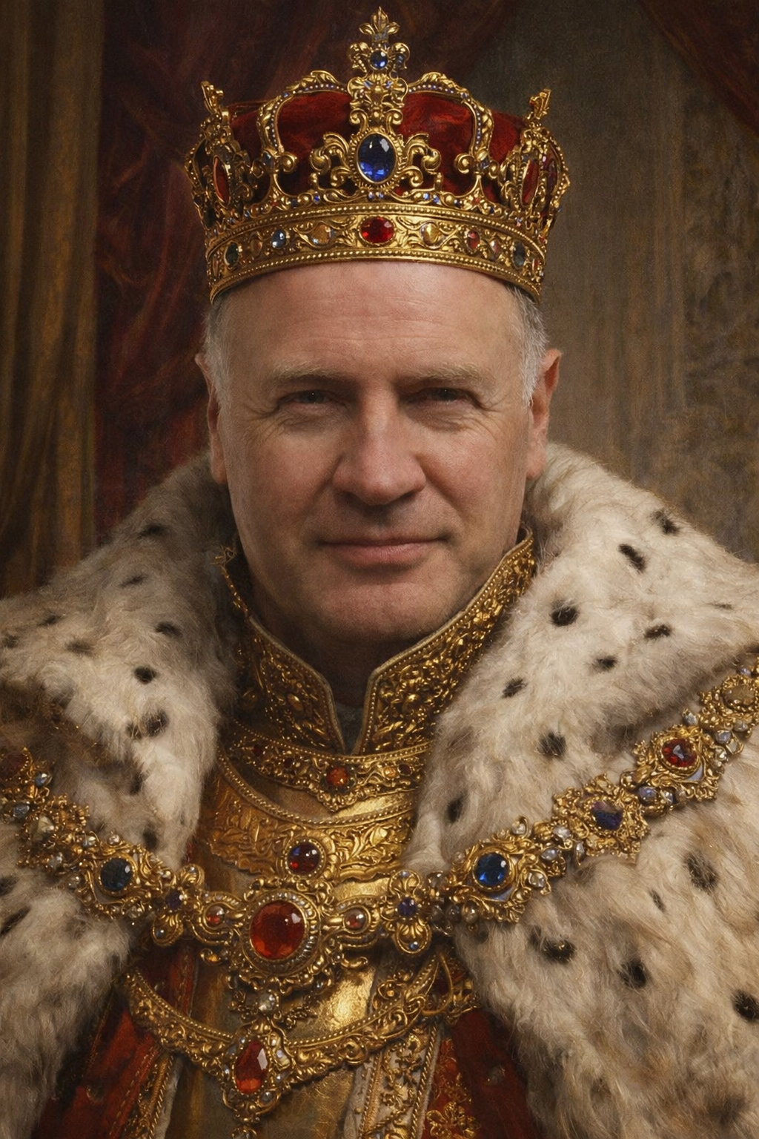
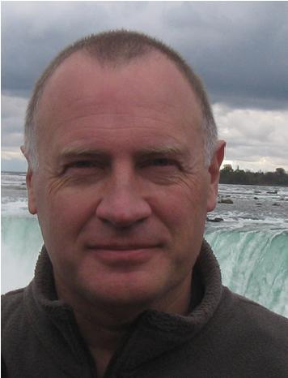
My Dream

Slide 14
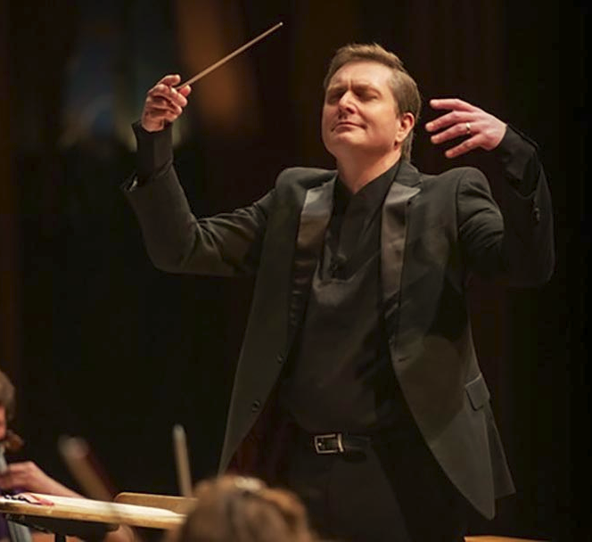

My Dream

Slide 15

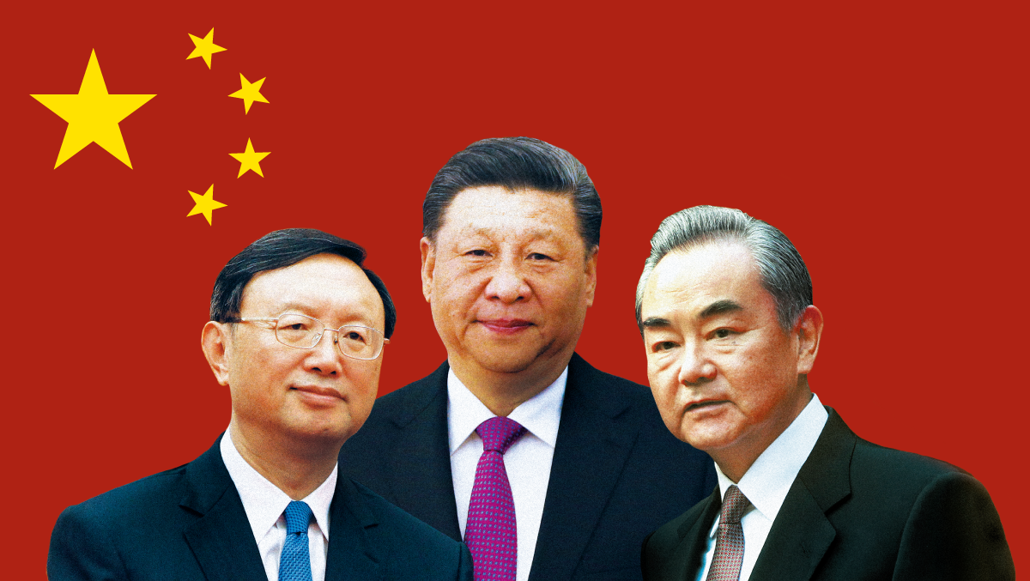
My Dream

Slide 16
Go Dream !

